Slide 1
Spatial workshop
8.30 -9.30 Intro to spatial analysis spatial autocorrelation and data cleaning (Søren and Zizka):
9.30-10.30 Startup of analyses. Data downloading.
10.30-11.00 Break.
11.00-12.30 Data cleaning and formatting.
12.30-13.30 Lunch.
13.30-14.30 Macroecological analyses of data
14.30-15.00 Wrapup.​

Slide 2
The world is round!

Slide 3
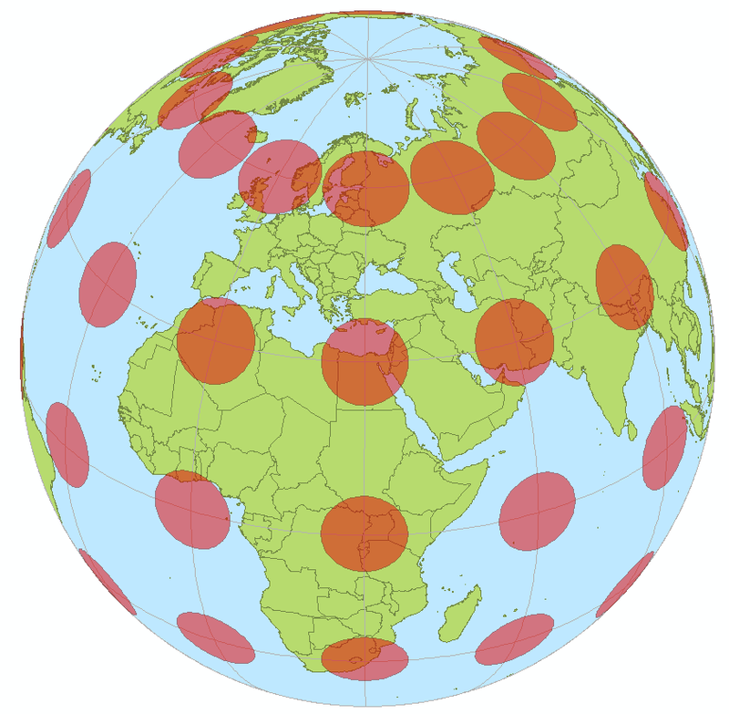
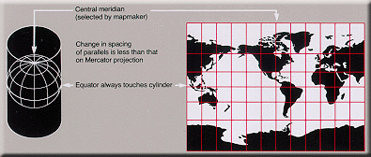
Cylindrical projections

Slide 4
Spherical distances

Slide 5
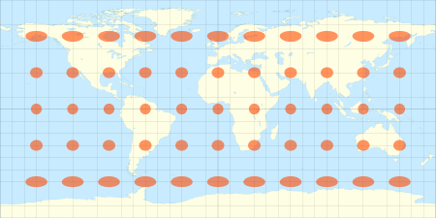
Equirectangular projection

Slide 6
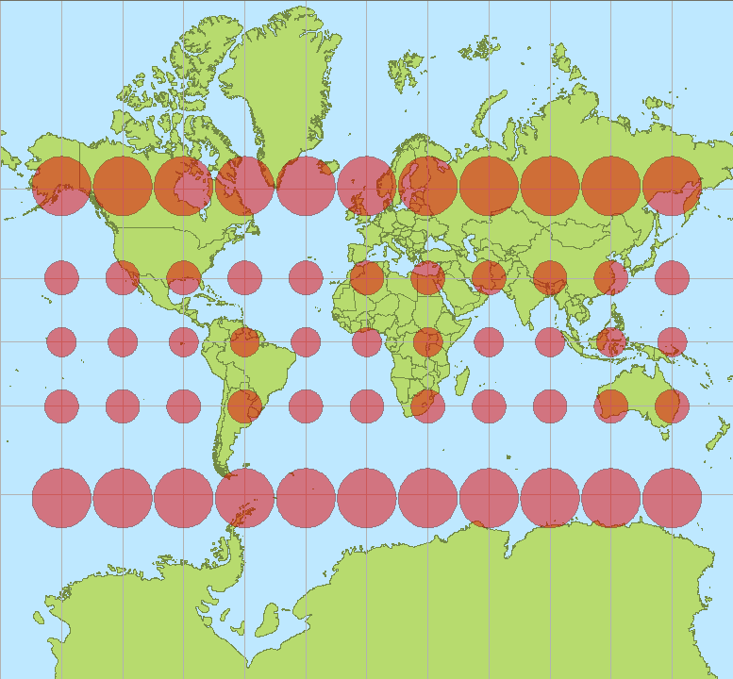
Mercaptor
http://hive.sewanee.edu/ldale/maps/10/06-LOCAL.html

Slide 7
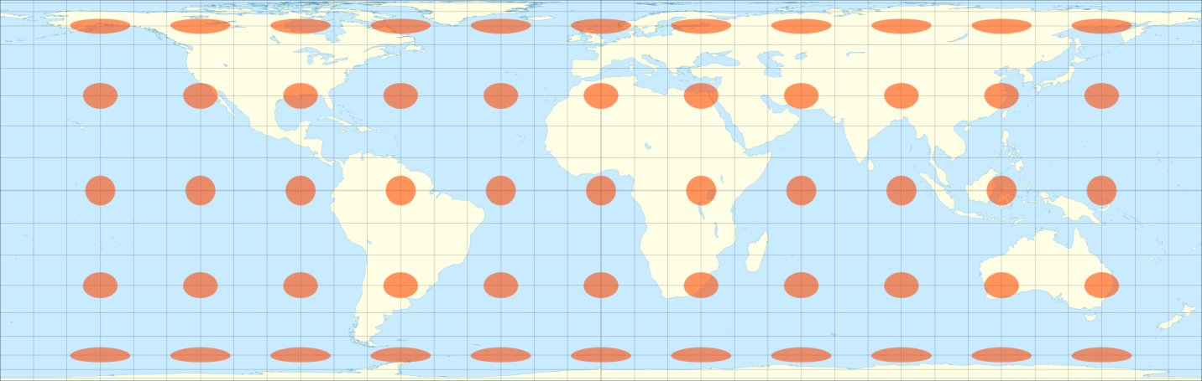
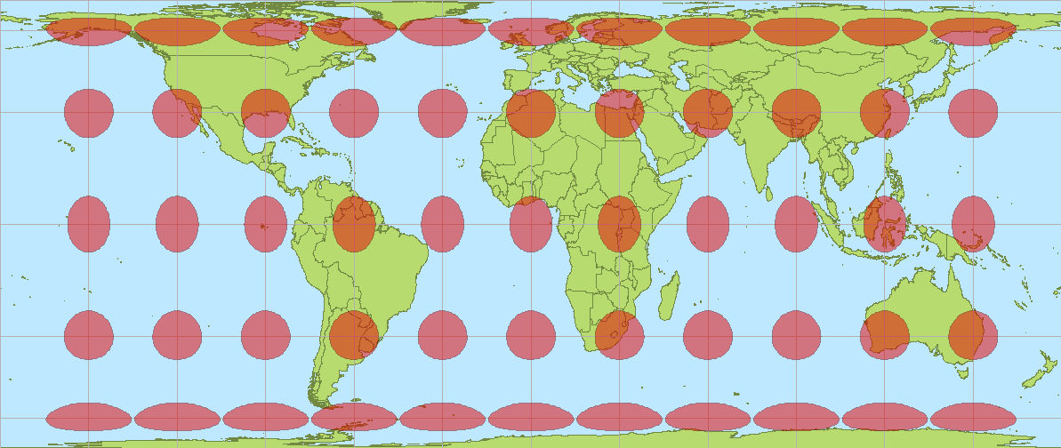
Cylindrical equal area
Lambert (0); Behrman 30)

Slide 8
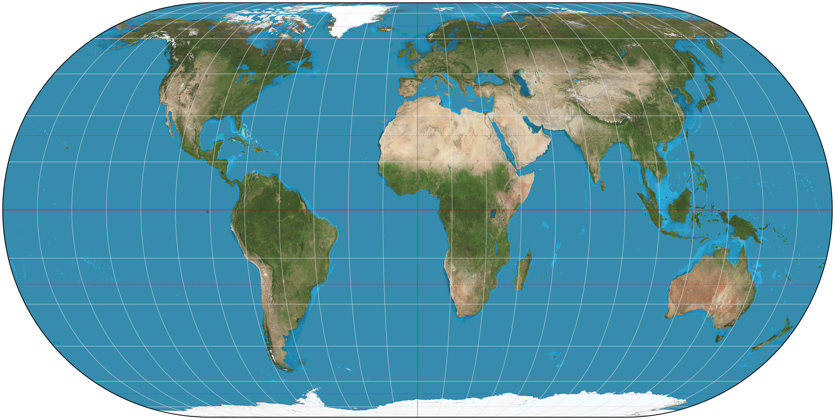
Pseudocylindrical projections
Eckert IV

Slide 9

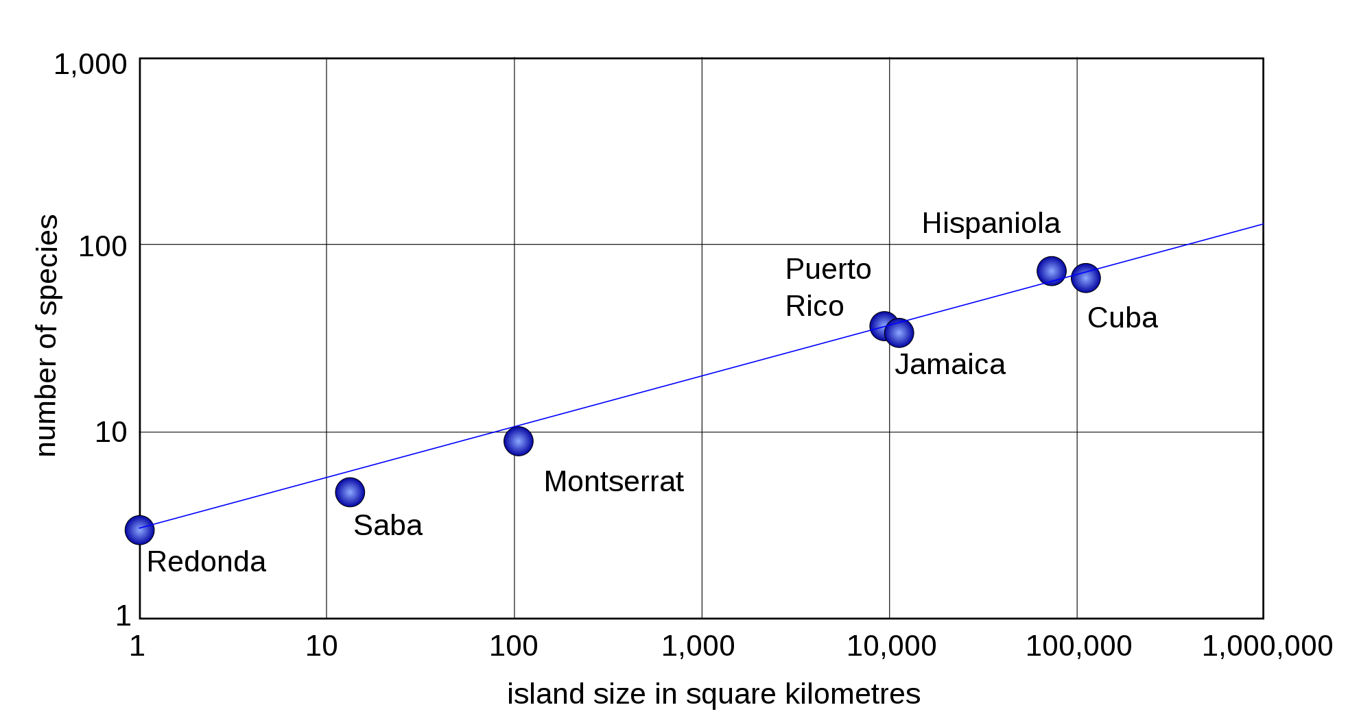
Area/ diversity

Slide 10


Slide 11
Neighoring areas are close to each other!

Slide 12
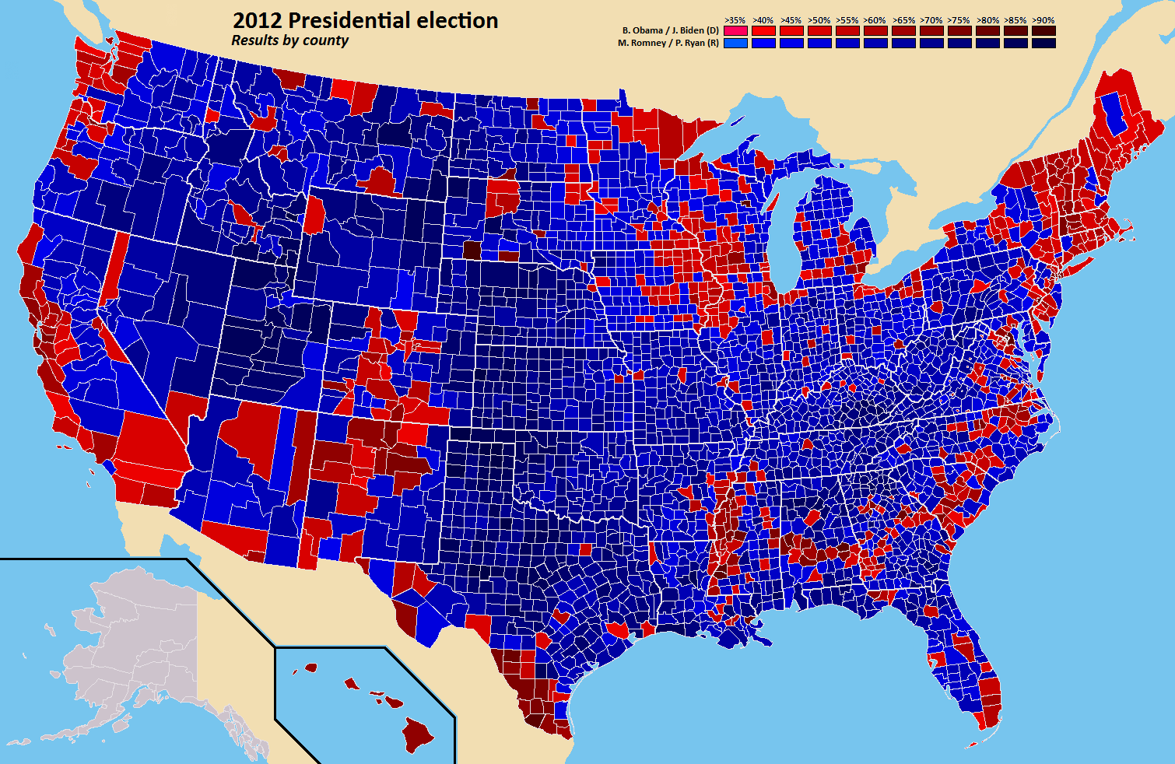
Effect of neighbours

Slide 13
Treatments
1) Add longitude and latitude to models
2) Use spatial filters
3) Use SAR regresions
4) (Subsampling)

Slide 14
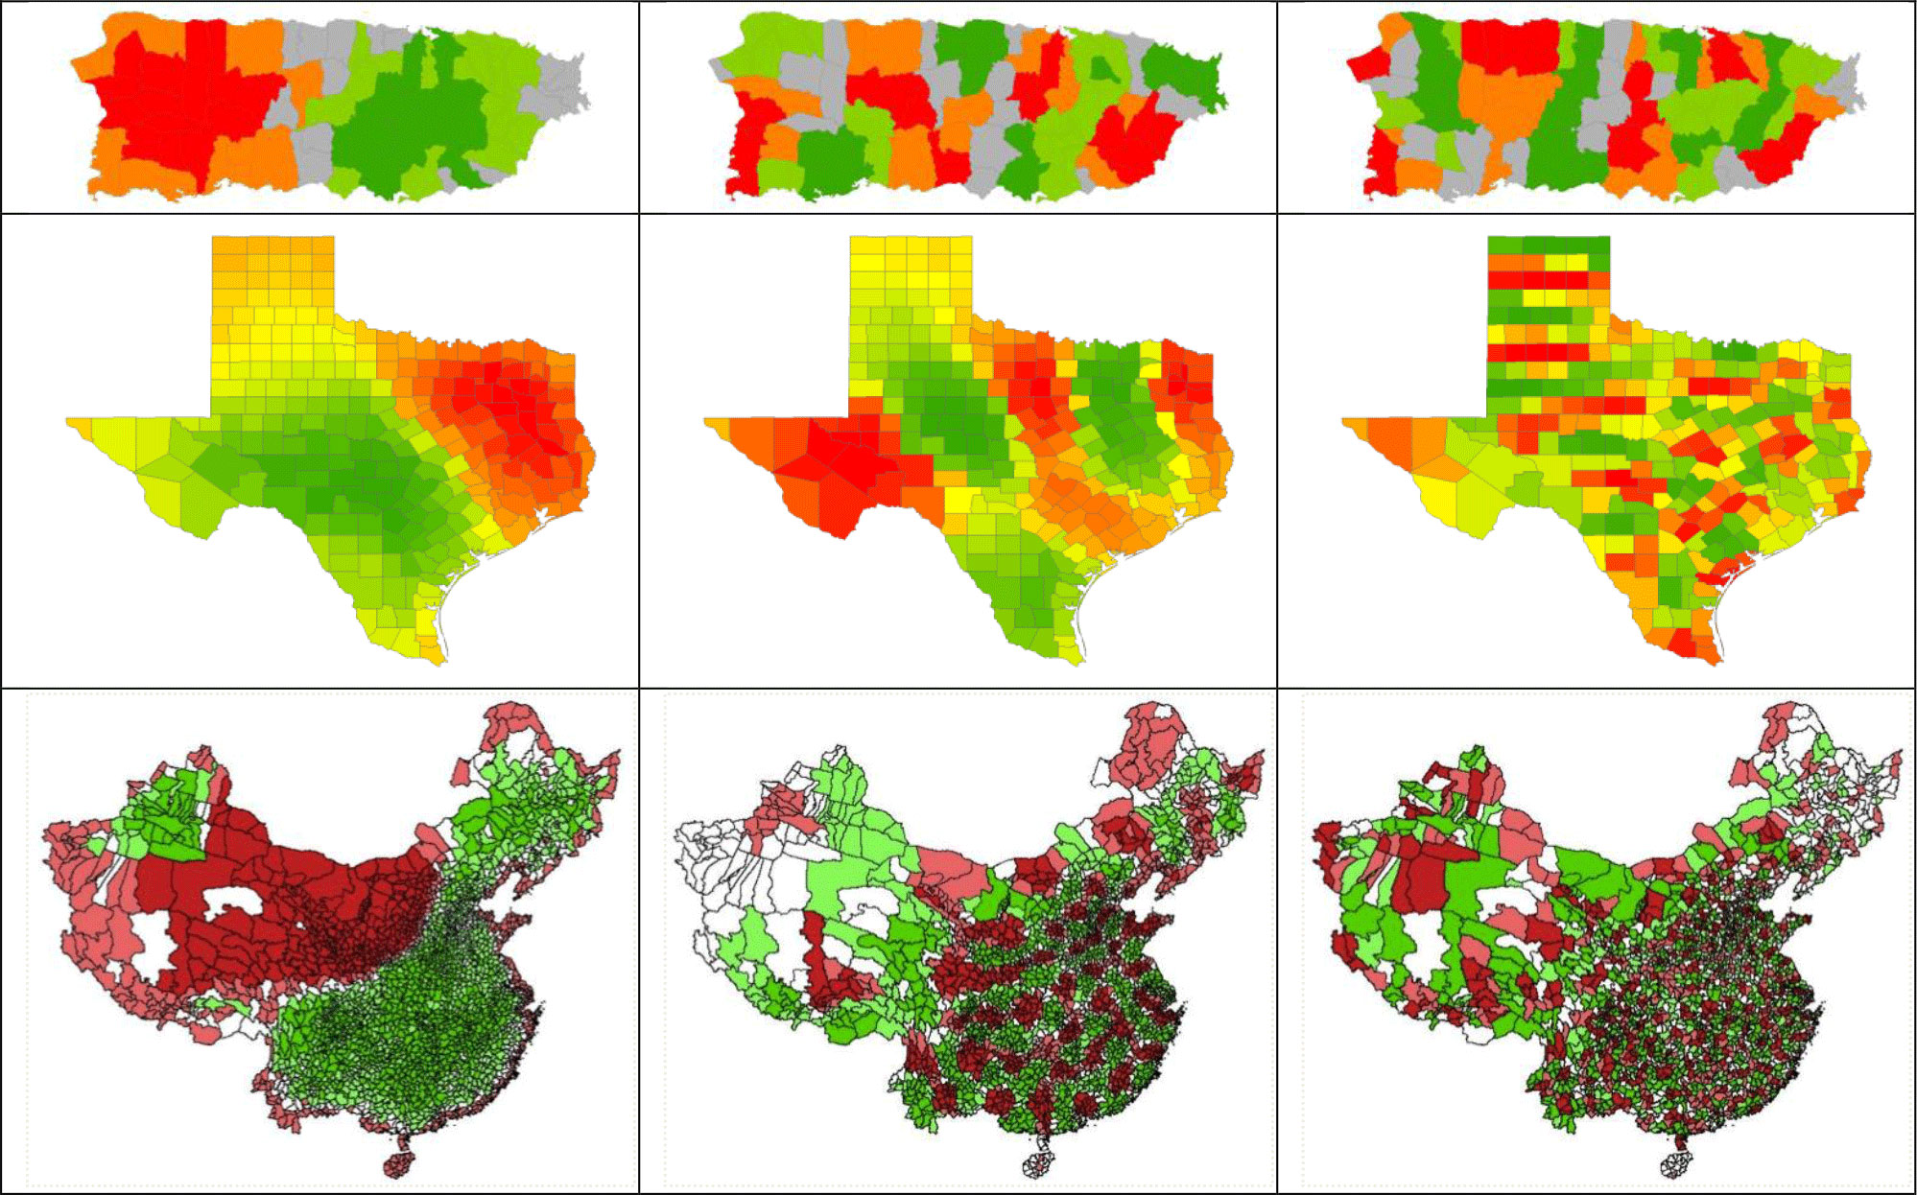
Spatial filters

Slide 15
Use of spatial filters
Calculate a pairwise distance matrix between all samples
Make PCA analysis of the distances
Add filters (axes from PCA until spatial autocorrelation is removed)

Slide 16
GLM / PGLS / SAR
GLM: Y=a₁X₁+a₁X₁…..+e
PGLS: Y=a₁X₁+a₁X₁…..+N(0,V)
SAR: Y=a₁X₁+a₁X₁…..+λWu+e

Slide 17
SAR in R
errorsarlm(formula, listw, zero.policy=T)
formula
Y=a₁X₁+a₁X₁….. (is specified just as glm)
listw
Specify neighborgood (i.e. what is used in the error term λWu)
zero.policy=T allows empty neighborhood sets

Slide 18
Number of neighbors
Neig=knn2nb(knearneigh(COORDINATES,Number_of_nei,ghbors, longlat = T))
1 Neighbour 12 neighbors

Slide 19
Distance to neighbors
Neig=dnearneigh(COORDINATES,d1 = 0, d2 = MAX_DIST, longlat = T))
0-500 0.250

Slide 20
Convert distance to weights
nb2listw(Neig,style="W",zero.policy =T) Style can be “W”, “B”, “C”, “U”, “minmax” and “S” see help(nb2listw).
Irrelevant for knearneigh

Slide 21
Modelperformance
Correlogram
correlog(X_VAR, Y_VAR, MODEL_RESID, increment =I, resamp=R,latlon=T)
Pseudo R²
write.table(predict.sarlm(MODEL), ”TEMP_FILE.txt")
read.table("TEMP_FILE.txt") ->PREDICT
file.remove("TEMP_FILE.txt")
Total
cor(Y_Variable, PREDICT[,1])^2
Parameter
cor(Y_Variable, PREDICT[,2])^2
Spatial
cor(Y_Variable, PREDICT[,3])^2

Slide 22
R stuff

Slide 23
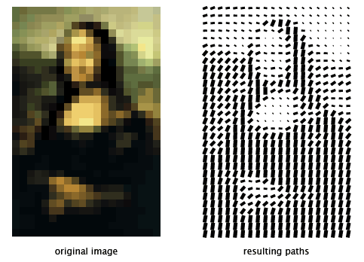
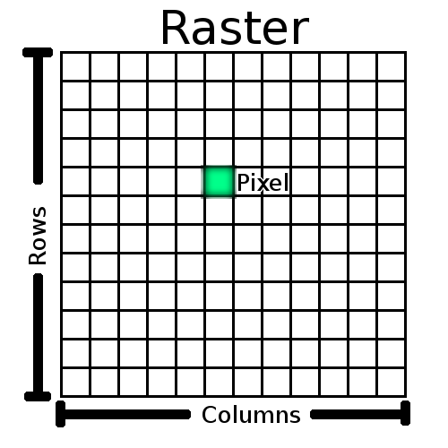
1
2 3 4
5 6 7 8

Slide 24
Polygons (shapefile)
Class "SpatialPolygonsDataFrame"

Slide 25
Rasters
library(raster)
Import / export: raster() / writeRaster()
Generate : rasterize
Many formats ”.tif” works well
Polygons
library(maptools)
Import readShapePoly
Many files in a ”shape file”

Slide 26
Convert polygon to raster
library(maptools)
readShapePoly
XY<-xyFromCell(”RAS”,”N1-N2”)
rast1 =rasterize(SHAPE[which(…),],”RAS”)
rast2 = rasterize(as(”RAS”[which(…),],"SpatialLines"),”RAS”)
rast3 = cover(rast1,rast2); temp = getValues(rast3); temp[which(is.na(temp) == T)]<-0; temp[which(temp >0)]<-1

Slide 27
Transform raster
Specify initial projection
Lat-long
” projection(“RAS”) <- "+proj=longlat +datum=WGS84 +ellps=WGS84 +towgs84=0,0,0“
projectRaster
resample
aggregate

Slide 28
SAR
library(raster); library(spdep); library(ncf) ; library(proj4)
Project
project, xyFromCell, ("+proj=cea +datum=WGS84 +lat_ts=30")
Neghborhood
knn2nb, knearneigh, nb2listw OR dnearneigh, nb2listw
SAR
errorsarlm
Check
correlog, Codes page 20 (predict.sarlm)

